Slide 1
Style Sheets

Slide 2
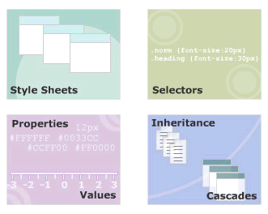
Module Introduction
Welcome to the module, Style Sheets.
This module introduces you to style sheets.
It also discusses how to use Cascading Style Sheets to format XML document.
Finally, the module explains the cascading order of style rules.
In this module, you will learn about:
  Stylesheets
  Selectors in CSS
  Properties and Values
  Inheritance and Cascades in CSS

Slide 3
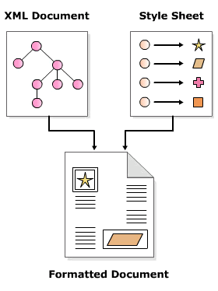
Need of Style Sheets
Style sheets are a set of rules that describe the appearance of data in an XML document.
XML describes data.
Style sheets define the appearance of data.
XML and style sheets are defined in separate files.

Slide 4

Various Style Sheets
Cascading Style Sheet
  Control the appearance of data in HTML and XML
Extensible Style Sheet
  Define the appearance of data contained only in XML documents.
  Also allows you to transform XML documents.

Slide 5
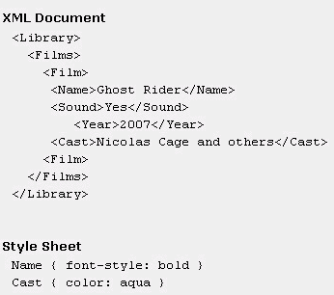

Cascading Style Sheets
A CSS style sheet comprises a set of rules for various elements in a document.
Each rule defines how the data enclosed in the element should be displayed.
Output

Slide 6

Style rules
A style sheet in CSS comprises a set of style rules.
Define how the content enclosed in an element will be displayed.
Applicable to all child elements within an element.
A style rule comprises:
  Selector
    Is an element name of an XML document
  Property
    Is a CSS style property that defines how the element will be rendered.
  Value
    The value associated with a CSS property.

Slide 7
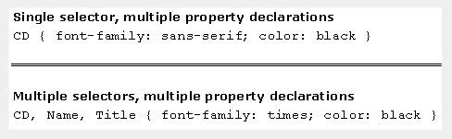
Ways of writing Style rules
A single selector can have more than one property-value pairs associated with it.
  property -value pairs are separated by a semi-colon (;)
A collection of one or more property-value pairs can be associated with more than one selector.

Slide 8
External style sheets
The style rules are written in a file with the extension .css.
This file is associated with an XML document using a style sheet processing instruction.
  It should appear in the prolog section of an XML document
  One XML document can have more than one style sheet
syntax
Example

Slide 9
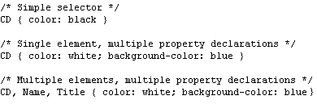
Simple Selectors
Simple selector comprises an element name followed by one or more property declarations.
Same property declarations can be assigned to multiple elements by separating element names with a comma.
Simple selectors match every occurrence of the element in a document.

Slide 10
Universal Selector
Comprises an asterisk (*) followed by property declarations.
Use to assign the same style rules to all the elements in a document.
Example:

Slide 11
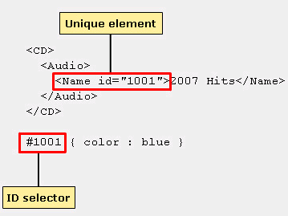
ID Selector
Comprises a hash (#) symbol + an attribute's value + property declarations.
Use to define styles for unique elements in a document.

Slide 12


Color Properties ($1/8)
To set the foreground and background color of text.
syntax
example

Slide 13
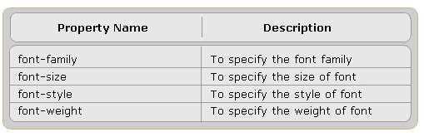
Font Properties ($2/8)
To set the font properties

Slide 14


Border Properties in CSS ($4/8)
Borders are rectangular outlines surrounding an element's box
syntax
example
output

Slide 15


Padding Properties in CSS ($5/8)
To insert space between the border and the text of an element,
syntax
example
output

Slide 16
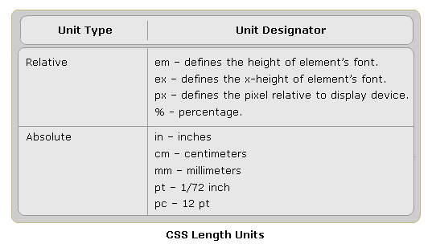
CSS Units
The values assigned to CSS properties are expressed in length units.

Slide 17
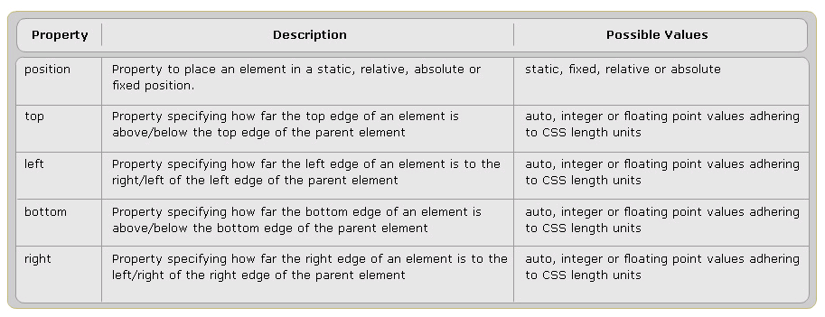
Position Properties ($6/8)
To position the text inside the box.

Slide 18


Position Properties Example
example
output

Slide 19



Display property ($7/8)
In HTML, if you wanted the text to appear as new paragraph, you would use the <P> tag.
The same can be achieved in XML by using CSS display property.
syntax
ouput
example

Slide 20


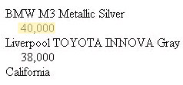
Text Alignment and Indentation ($8/8)
To align and indent the text in their own box
syntax
example
output

Slide 21
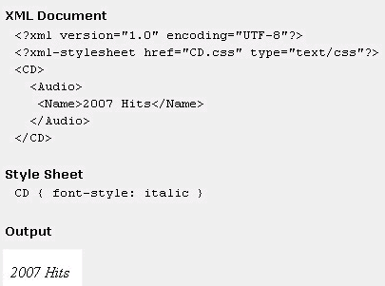
Inheritance in CSS
The ability of one entity to acquire the characteristics of another entity.
In CSS, the child elements inherit the styles rules defined for parent element.
If the child has style rule, its rule will overrides the parent style rule.

Slide 22
That’s all for today!
Stylesheets
Selectors in CSS
Properties and Values
Inheritance and Cascades in CSS
Thank you all for your attention and patient !

